Slide 1
A New (and better) Way to Characterize and Evaluate Your Teaching (and everyone else’s)
Carl Wieman
Stanford University
Department of Physics and Grad School of Education
“A better way to evaluate undergraduate science teaching” Change Magazine, Jan-Feb. 2015, Carl Wieman
“The Teaching Practices Inventory: A New Tool for Characterizing College and University Teaching in Mathematics and Science”
Carl Wieman and Sarah Gilbert
(and now engineering & social sciences)
http://www.cwsei.ubc.ca/resources/TeachingPracticesInventory.htm
20-30 minutes of presentation- ok to interrupt with questions & lots of time at end.

Slide 2
Necessary (and probably sufficient) 1st step-
for widespread adoption of effective research-based teaching…
a good way to evaluate teaching quality
Requirements for good evaluation:
reflects what matters-- what leads to most learning
fair-- valid/fair for use in all courses, all institutions (allows meaningful comparisons)
actionable– tells how to improve, & measures when do
practical– requires modest time
student course evaluations fail on all but #4

Slide 3
Problems with student course/instructor evals
no correlation with learning
(Clayson, D. "Student Evaluations of Teaching: Are They Related to What Students Learn?: A Meta-Analysis and Review of the Literature." Journal of Marketing Education 31, no. 1 (2009): 16-29.
New good study in physics- July ‘18 Am J. Phys.)
no correlation with use of better teaching methods
(cwsei & others)
poor guide as to how to improve
confounding variables outside instructor control
(class size, elective vs req., appearance, gender!)
2 good recent studies, large (~ 1 S.D. ) gender bias
questions?
“What’s in a Name: Exposing Gender Bias in Student Ratings of Teaching”, MacNell, Driscoll, Hunt, Innov Higher Ed. (2015) 40:291–303
“Swimming against the Tide: Gender Bias in the Physics Classroom”, Graves, Hoshino-Browne, and Lui, J. Women and Minorities in Sci. & Eng. May 2017

Slide 4
How to do better?
Advances in research on teaching & learning provide a way
My previous ASMCUE talk—2 minute summary

Slide 5
Research on university teaching
~ 1000 research studies from all undergrad sciences and engineering, all levels, comparing traditional lecture with “scientific teaching”.
consistently show greater learning
lower failure rates
benefit all, but usually at-risk more
Massive meta-analysis
PNAS Freeman, et. al. 2014

Slide 6
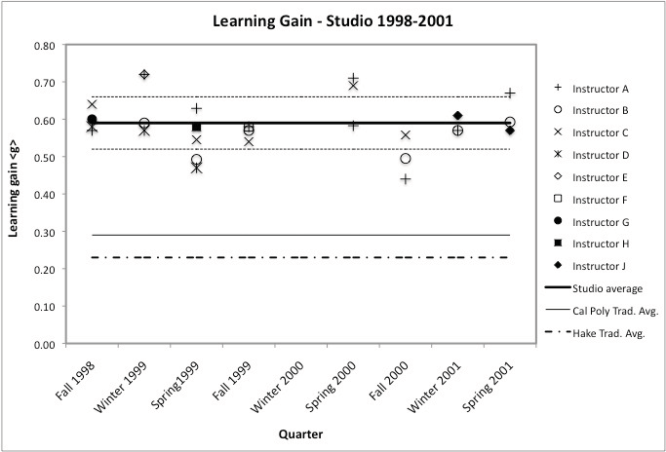
Apply concepts of force & motion like physicist to make predictions in real-world context?
average trad. Cal Poly instruction
1st year mechanics
Cal Poly, Hoellwarth and Moelter,
Am. J. Physics May ‘11
9 instructors, 8 terms, 40 students/section.
Same instructors, better methods = more learning!

Slide 7
U. Cal. San Diego, Computer Science
Failure & drop rates– Beth Simon et al., 2012
same 4 instructors, better methods = 1/3 fail rate
Notes:
Intuition behind CS1.5 is that CS1 is the immediate pre-curser to CS1.5. What likely occurred here was that, with standard instruction, the students who might have failed CS1.5 were already gone having failed CS1 and having not returned. So CS1.5 with standard instruction has a much improved fail rate, but that’s misleading...

Slide 8
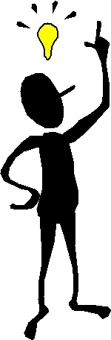
Relevance to the evaluation of teaching
What does the data say makes a good teacher?
“Good” teacher= teacher that uses good practices
Evaluate teaching by looking at the instructional practices used— a better proxy for learning
Analogous to medicine/hospitals
Create simple efficient way to characterize teaching
.
.
.
. 3 years & ~ 6 iterations later
.

Slide 9
“The Teaching Practices Inventory: A New Tool for Characterizing College and University Teaching in Mathematics and Science”
Carl Wieman* and Sarah Gilbert
(and now engineering & social sciences)
Try yourself. ~ 10 minutes to complete.
http://www.cwsei.ubc.ca/resources/TeachingPracticesInventory.htm
Provides detailed characterization of how course is taught
64 items, 8 categories
few subjective judgements (= fast, accurate)

Slide 10
8 categories
I. Course information provided Information about the courses, such as list of topics and organization of the course, and learning goals/objectives.
II. Supporting materials provided Materials provided that support learning of the course material, such as notes, video, and targeted references or readings.
III. In-class features and activities What is done in the classroom, including the range of different types of activities that the instructor might do or have the students do.
IV. Assignments Nature and frequency of the homework assignments in the course.
V. Feedback and testing Testing and grading in the course, and the feedback to students and feedback from students to instructor.
VI. Other Assorted items covering diagnostics, assessment, new methods, and student choice and reflection.
VII. Training and guidance of teaching assistants What selection criteria and training is used for course teaching assistants, and how their efforts are coordinated with other aspects of the course.
VIII. Collaboration or sharing, use of research, in teaching Collaboration with other faculty, use of relevant education research literature, and use of educational materials from other sources.

Slide 11
CWSEI Teaching Practices Inventory
With slight modifications to extend use to social sciences

Slide 12
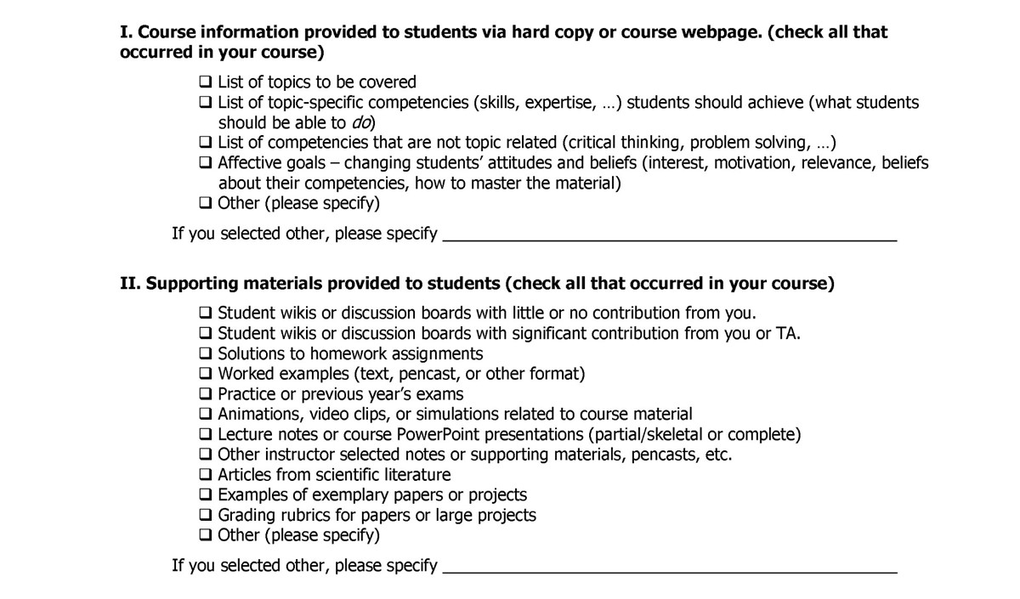

Slide 13
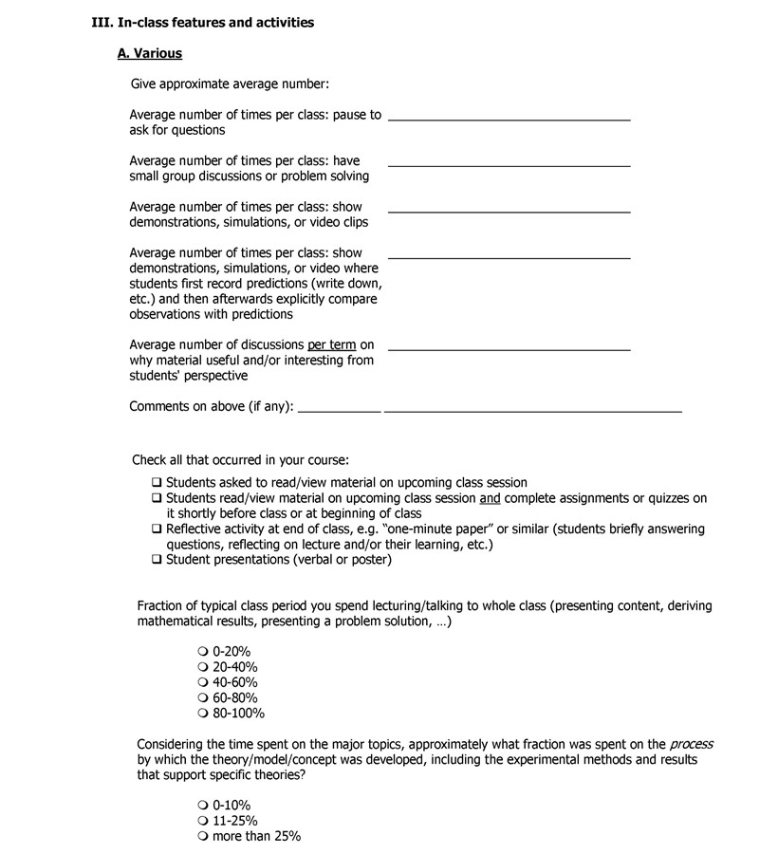

Slide 14
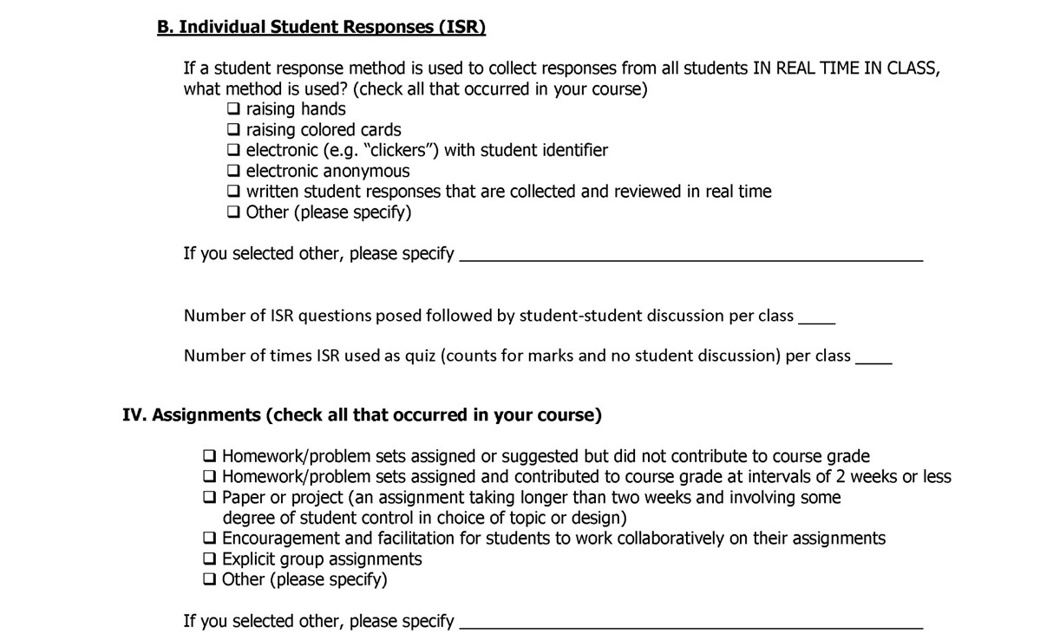

Slide 15
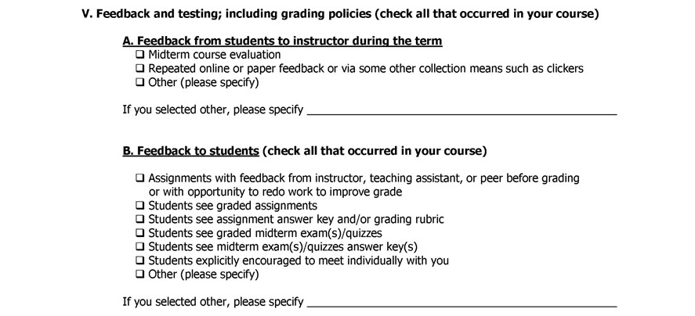
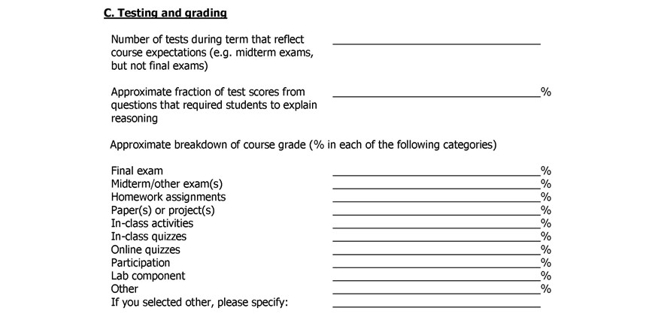

Slide 16
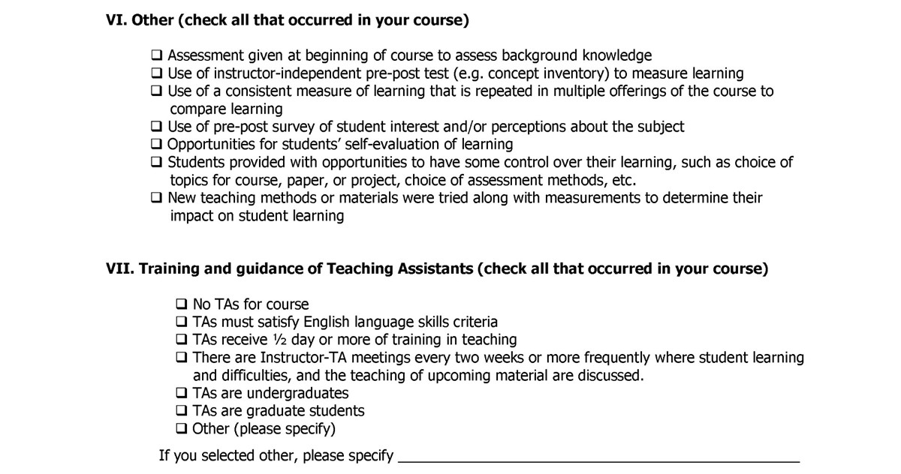

Slide 17
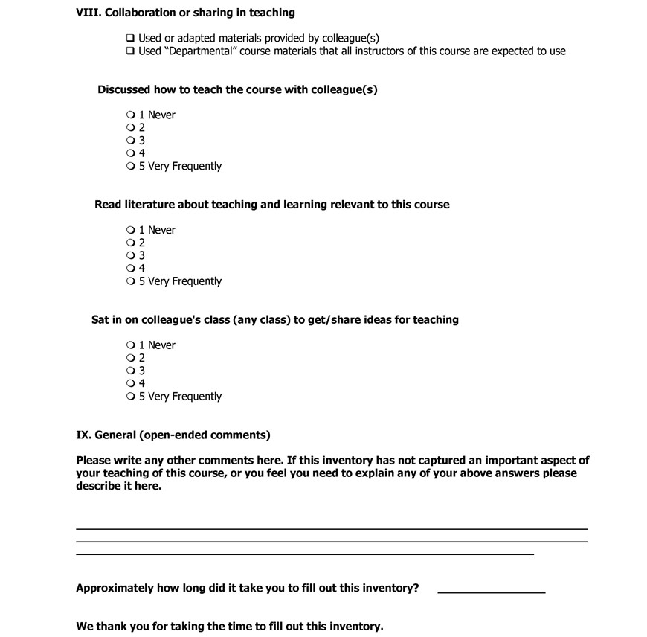

Slide 18
Very few subjective judgments-- ~10 minutes per course to complete
Detailed characterization ~ all instructor decisions
in teaching a course
Measure extent of use of teaching practices research shows produce greater learning.
51 of the 64 items have 1,2, or 3 “effective teaching practices” points
ETP score for each category, and overall total for course (Download Excel scoring file from website.)
Equally valid/fair for all courses, all institutions.
(Except lab & seminar courses—too variable)

Slide 19
TPI example (pg 1 of 4)
(Scoring rubric points are the numbers in bold to right of each item.)
___________________________________________________
I. Course information provided to students via hard copy or course webpage. (check all that occurred in your course)^{[1]}
List of topics to be covered 1
List of topic-specific competencies (skills, expertise, …) students should achieve (what students
should be able to do) 3
List of competencies that are not topic related (critical thinking, problem solving, …) 1
Affective goals – changing students’ attitudes and beliefs (interest, motivation, relevance, beliefs
about their competencies, how to master the material) 1
Other (please specify)
If you selected other, please specify________________________________________
II. Supporting materials provided to students (check all that occurred in your course)
Student wikis or discussion boards with little or no contribution from you 0
Student wikis or discussion boards with significant contribution from you or TA^{[2]} 1
Solutions to homework assignments^{[3]} 1
Worked examples (text, pencast, or other format) 1
Practice or previous year’s exams 1
Animations, video clips, or simulations related to course material 1
Lecture notes or course PowerPoint presentations (partial/skeletal or complete)^{[4]} 1
Other instructor selected notes or supporting materials, pencasts, etc. 0
Articles from scientific literature^{[5]} 1
Other (please specify)
If you selected other, please specify________________________________________
III. In-class features and activities
A. Various
Give approximate average number:
Average number of times per class: pause to ask for questions ___ (1 if >3)
Average number of times per class: have small group discussions or problem solving ____ (1 if 1, 2 if >1)

Slide 20
How to use?
Individuals- fill out to evaluate themselves, get
ideas for what to change to improve
Faculty fill out:
guide professional development
add to personnel file as evidence of teaching
department/institution characterization of instructional practices
evaluation--incentives
I trust faculty, but if not, easy to check nearly all
In-class my biggest concern. Underestimate time
talking? Preliminary—not.

Slide 21
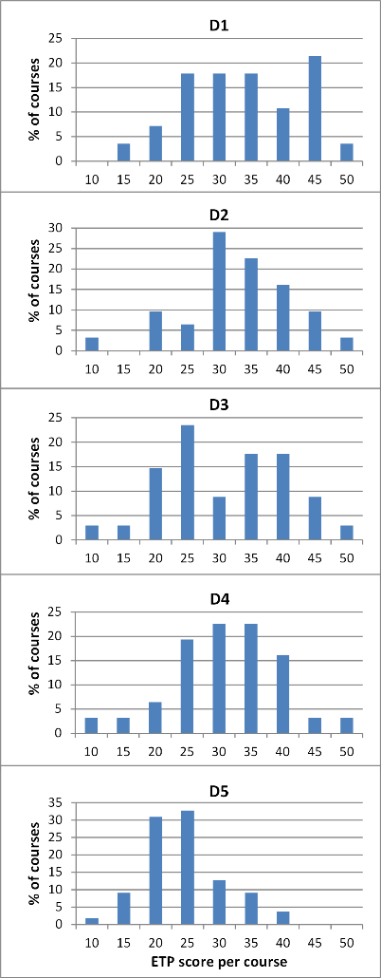
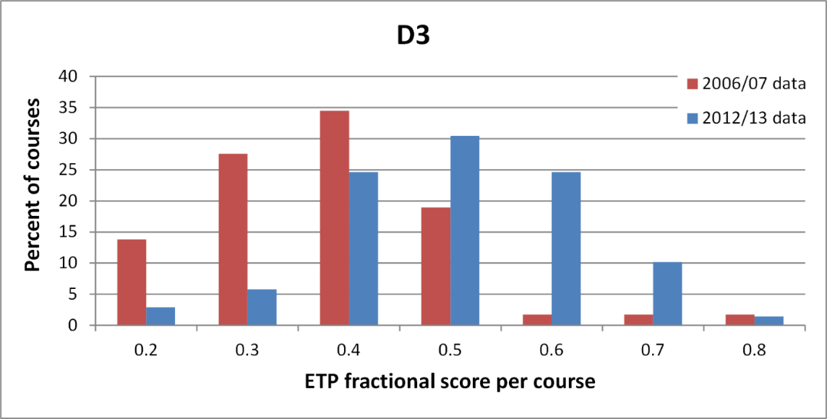
“Effective teaching practices (ETP)” scores/course UBC depts
Every dept– completely new info, surprised at large spread!
High level of discrimination
Identified faculty doing good things. Identify areas for improvement.
Guide, track & document improvement. Individual & dept.
before and after for EOAS

Slide 22
Benefits of looking at teaching practices
(what provides beyond student course evaluations)
Reflects quality of teaching practices used.
Also clearly guides and measures improvement.
2. Equivalent comparison over all courses.
Entirely under instructor control

Slide 23
Questions and discussion
http://www.cwsei.ubc.ca/resources/TeachingPracticesInventory.htm
website has Qualtrics file of TPI, and Excel scoring file you can download

