Slide 1
UT Math Assessment (UTMA)
Step by Step Instructions

Slide 2
Five Steps to complete the UT Math Assessment:
Step 1: Purchase the Math Readiness Package.
Step 2: Access your Quest Learning Modules.
Step 3: Complete the mandatory Warm-Up assessment.
Step 4: Utilize the Quest Learning Modules to assess your skills.
Step 5: Take UT Math Assessment. You will discuss your results at orientation.

Slide 3
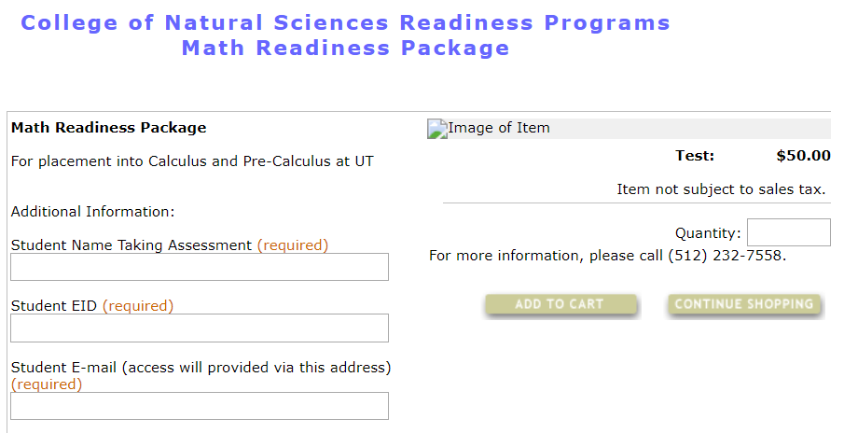
Step 1: Purchase the Math Readiness Package
Purchase at the link below:
Math Readiness Package

Slide 4
Step 2: Access your Quest Learning Modules
Follow the “Click to Download” link provided in your electronic TX Shop receipt to access the Quest Learning Modules.
Included in the Math Readiness Package:
Quest Learning Modules
Mandatory Warm-Up assessment for access to the UT Math Assessment
Assessment instructions for the UT Math Assessment
Access for two semesters to the Math Readiness Package

Slide 5
Step 3: Complete the (mandatory) Warm-Up assessment
The Warm-Up assessment time commitment is one hour; just like the UTMA.

Slide 6
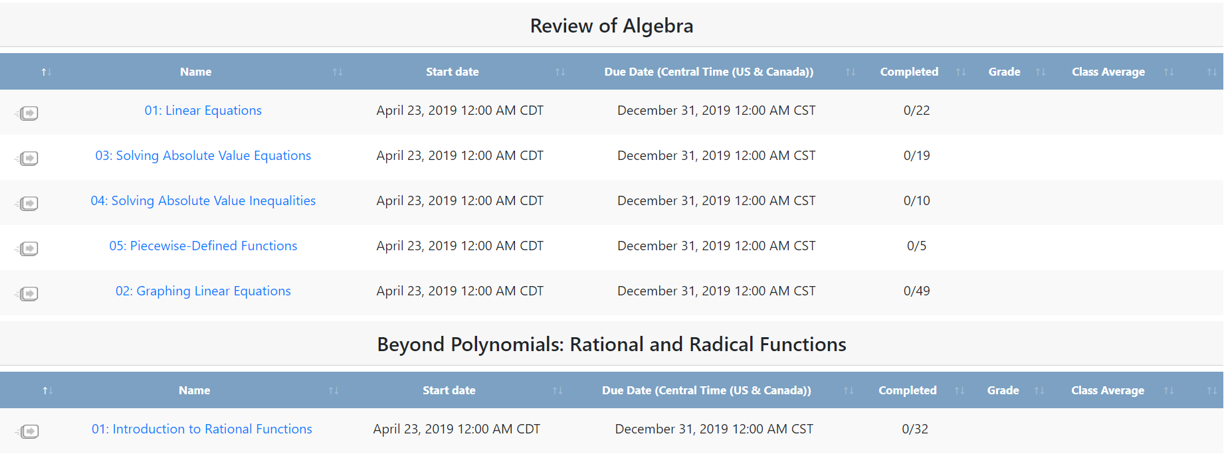
Step 4: Access the Quest Modules to assess your skills.
(Not mandatory but highly encouraged!)

Slide 7
Step 5: Take the UT Math Assessment
Access to the online, proctored UTMA access will be granted within a few hours after completing the Warm-Up assessment.
Your UTMA results will be available in the Math Readiness Package in five hours.

Slide 8
Step 6: UTMA RESULTS
Your individual UTMA results and course information will be discussed in your academic advising appointment at Orientation. Your academic advisor is an expert at UT, and preparing a list of your questions is recommended.
If you do not meet the prerequisite requirement for pre-calculus or calculus, a second attempt will become available beginning on June 30th. Work through the Quest Learning Modules (and the time recommendation in your initial results) to prepare for your second attempt.
The pre-requisite deadline for calculus courses at UT Austin occurs in August.

Slide 9
Have a specific question?
Math Readiness Package: For any technical issues in the Math Readiness Package or UT Math Assessment.
questhelp@austin.utexas.edu Please include your UT EID.
UT Math Assessment Results and Fall Course Options: Questions about your results can be discussed during your academic advising appointment at orientation. Ask questions, discuss course options, and email your academic advisor after orientation. Please include your UT EID.
Pre-calculus and Calculus Prerequisite Requirements: For any pre-requisite requirement concerns for calculus courses at UT Austin.
mpaadv@austin.utexas.edu Please include your UT EID.

