Slide 1

Teaching Spotlight Workshop:
Influencing Student Motivation and Learning Mindset
Brandon Campitelli, Sarah EichHorn, Keely Finkelstein, Jennifer Fritz, Kristin Patterson

Slide 2
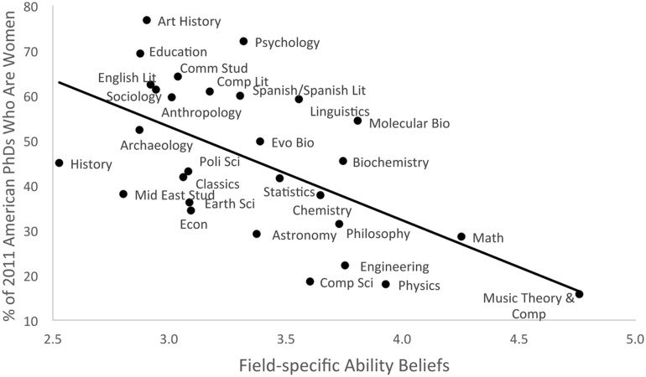
What is the relationship shown here?
In other words, how should the X-axis be labeled?
Meyer, et al. (2015) Front Psychol 6, 235
Leslie, et al. (2015) Science 347 (6219), 262-265

Slide 3
Fewer females complete PhDs in fields believed to require talent or innate skill
This pattern is also true for African Americans.
Meyer, et al. (2015) Front Psychol 6, 235
Leslie, et al. (2015) Science 347 (6219), 262-265

Slide 4
Attitudes and beliefs can affect learning
Fixed mindset
Intelligence is a fixed trait
Success is due to talent
People with a fixed mindset have a difficult time handling setbacks– failure means you lack competence or potential.
Growth mindset
Intelligence and ability is developed through effort
Success is due to effort, trying new things, and seeking help
People with a growth mindset love learning and have resilience.

Slide 5
Case studies
Find a teammate
Choose and read a case study with your teammate
about a chemistry major
about a pre-med biology major
about an aspiring computer scientist
Discuss your responses to the questions with your teammate

Slide 6
Case study 1
I’m a chemistry major. Because it’s required for my degree, I’m taking a history class that is for science majors. No one wants to take this class, but we all have to. We meet three times per week at 9am (why does anyone think 9am classes are a good idea?). The class is in a large auditorium and the professor stands in the front and tells stories about stuff that happened so long ago that it’s not even important anymore. I’m not too worried though because students who have already taken the class told me the tests are easy and everything you need to do well is written on the slides. I can’t really see the slides very well in class, but I can download them from Canvas. We already took the first exam and they were right. So, I sit in the back of the room and either sleep or scroll through memes. Sometimes I put my earbuds in and listen to music. Everyone around me in class is doing the same.

Slide 7
Case study 2
I am a sophomore majoring in Biology. My life dream is to go to medical school and become an osteopathic surgeon. I’ve gotten A’s in all of my courses so far, which is great since GPA is so important for getting into medical school. For my degree, I have to take a couple of physics classes, which I think is ridiculous. What does physics have to do with biology? Plus, I already took physics in high-school. I approach this class like most others: I attend lecture (although I can’t say I understand what’s being taught), do the labs, and turn in the homework. I’m getting irritated because I don’t understand the point of calculating the forces on a block of wood, and the homework and lab write ups take a huge amount of time. I would rather be spending that time learning something about the human body. The first midterm exam in this course was NOT what I expected. The problems weren’t like the homework at all and I don’t think we had covered all of the topics asked on the exam. We had to solve really hard problems in a short time. I didn’t even get to two of the questions. I got a 45% on that test. This class is going to destroy my GPA and I won’t be able to get into medical school. This is total BS. Why should my dreams get crushed by a class that shouldn’t even be required anyway? I’m going to drop this class and take physics somewhere else.

Slide 8
Case study 3
This is my first year in college, although I’m technically a Sophomore because I started with about 30 credits from dual-credit and AP classes. I haven’t declared a major yet, but I’m super interested in computer science because everyone uses computers and I think being able to use computers will help me get a good job after college. Being qualified for a high-paying job is important to me because I will have a lot of student loans to pay for college. I totally breezed through high school. It was so easy. Last semester wasn’t so easy, but I got mostly A’s in my courses, only one B, which is great because my GPA has to be above 3.0 to keep my scholarship. This semester, I enrolled in an introductory computer science class. The class isn’t what I expected. First of all, the problems we do have a lot of math, which I’m not good at. Also, the professor is teaching us about coding, but the code looks like a foreign language to me and he goes so fast that I’m lost after the first 10 minutes. The teacher also calls on students to answer questions in class. I’m so afraid of being called because I’ll just embarrass myself in front of everyone. I don’t go to office hours either for the same reason. Most of the grade depends on weekly homework assignments. Some students talk about how easy they think the homework problems are. I think they’ve done this before. When I read the problems, they make no sense to me. I know I’m going to fail this class, and if I do I might lose my scholarship.

Slide 9
What is motivation?
Expectancy
Motivation
Value

Slide 10
What is expectancy?
The degree to which a student expects to succeed
Linked to self-perception and confidence
Students work to preserve their sense of self-worth. In the face of possible failure, they may not try, rather than try and fail.
Students are more confident when they have control over the factors that determine success
Without the hope of success, there is no motivation!

Slide 11
What is value?
Extrinsic—
Examples: parents’ expectations, earning potential, grades
Advantages: little effort required, quick to act
Disadvantages: short-lived, can distract from learning
Intrinsic—
Examples: love of subject, relevance to life, sense of accomplishment
Advantages: long-lasting, self-sustaining, promotes learning
Disadvantages: takes time, different for every student
Without a sense of value, there is no motivation!

Slide 12
What effects does motivation have on learning?
 | Expects to succeed | Does not expect to succeed
Values the task | Motivation! Student eager to learn, challenge existing understanding, and integrate learning across topics | Student pretends to understand or denies having difficulties. Focused on protecting the ego
Does not value the task | Evades the task, does the bare minimum, attention drifts to other interests | Resists or rejects the task; may be angry and resentful; may be worried about embarrassment and perceptions of low ability

Slide 13
List of tips and strategies
Read through the ideas on the handout
  Put a ✔️ by the ones you think you already do well
  Put an * by the ones you would like to know more about

Slide 14
Notes:
Modeling

Slide 15
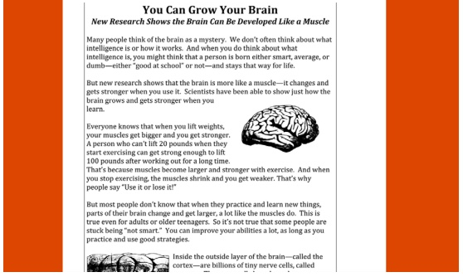
Growth mindset intervention
Students read an informative article about how intelligence can be developed through effort.
Students then wrote essays to future students who might be struggling academically and who might feel like they aren’t smart enough.
Yaeger, et al. (2016) PNAS 113 (24) E3341-8

Slide 16
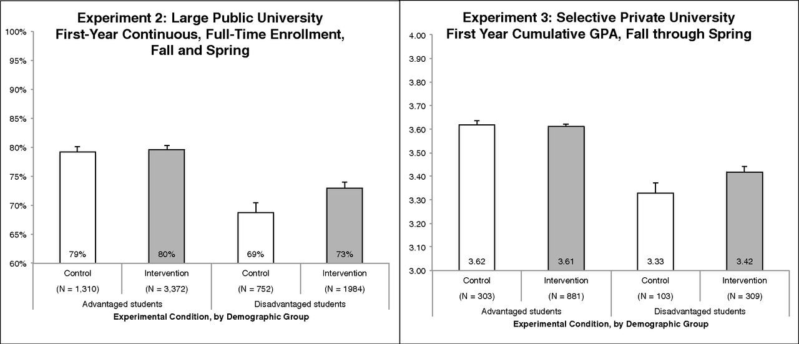
Mindset intervention has benefits for disadvantaged students
Yaeger, et al. (2016) PNAS 113 (24) E3341-8

Slide 17
Values affirmation intervention has positive impact on women in physics
Circle two or three of the values listed below that are most important to you.
(being good at art; creativity; relationships with family and friends; government or politics; independence; learning and gaining knowledge; athletic ability; belonging to a social group; music; career; spiritual or religious values; sense of humor)
Describe in a few sentences why the values you circled are important to you. Focus on your thoughts and feelings. Do not worry about spelling, grammar, or how well written your answer is.
Look at the values you chose again. List the top two reasons why these values are important to you.
Miyaka, et al. (2010) Science 330 (6008) 1234-1237

Slide 18
More References
https://serc.carleton.edu/NAGTWorkshops/affective/motivation.html
https://cft.vanderbilt.edu/guides-sub-pages/motivating-students/
Dr. Carol Dweck
  https://www.edweek.org/ew/articles/2015/09/23/carol-dweck-revisits-the-growth-mindset.html
  https://www.youtube.com/watch?v=hiiEeMN7vbQ
Elizabeth Barkley, Student Engagement Techniques, Wiley, 2010
Two guys on your head
http://kut.org/post/imposter-syndrome-and-why-its-hard-make-it-when-you-fake-it

